Slide 1





JavaScript
Basics

Slide 2

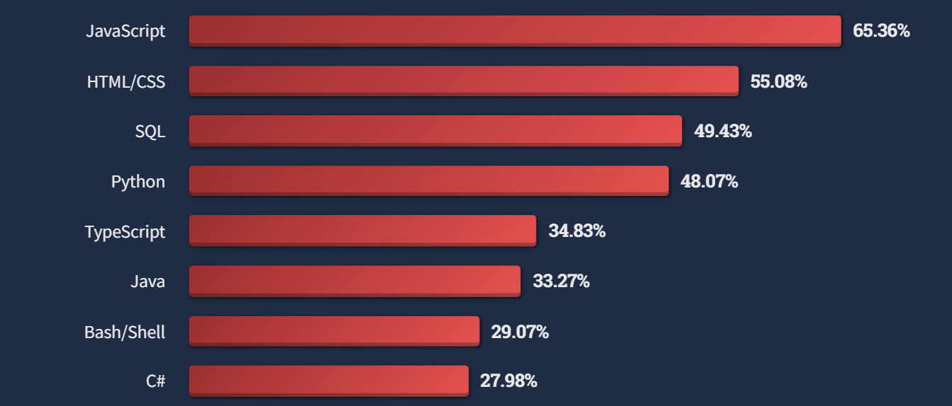
Used by almost 98% of 1.8 B websites
Most Popular language from 11 years
JavaScript is programming language for developing complex logics in the web pages as well as used for developing server side applications
stackoverflow survey 2023

Slide 3
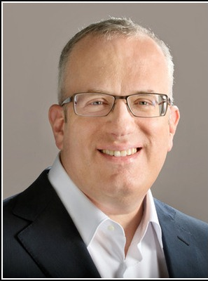


Timeline of JavaScript and its Frameworks and Libraries
Mocha
JavaScript
LiveScript
Brendan Eich
1995
JS
Javascript

Slide 4






Timeline of JavaScript and its Frameworks and Libraries
Ecmascript
Angular.js
REACT JS
Brendan Eich
1995
2006
2012
2016
JS
ES
TS
JavaScript
JScript
1997
2010
2013
Javascript
JQuery
TypeScript
Angular

Slide 5

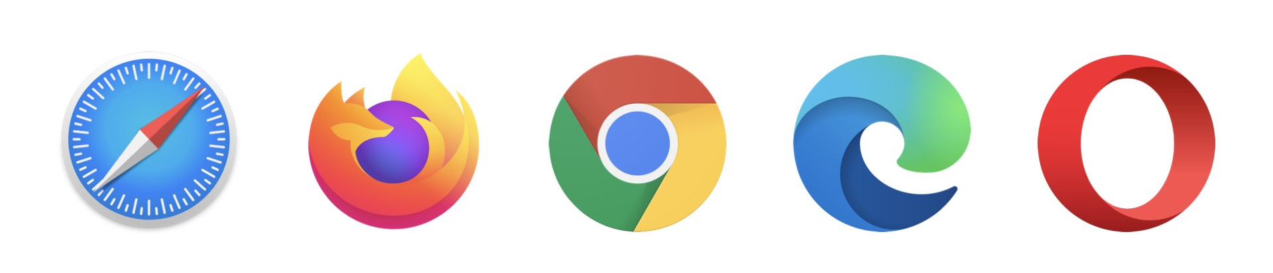
Using JavaScript on
Client Side
Server Side
Client side means running JavaScript on Browser in the form script with HTML file.
Server side means running JavaScript on a server using a runtime environment such as Node in the form script with HTML file.

Slide 6

Writing and Executing Javascript code on a Server

Slide 7
Data Types
Number
1. Number
All the Integers and float data are included in number. Ex. 23, 23.43, -43
Number
2. String
All the characters and text are considered as string in JS. Ex. ‘abc’ , “xyz”
Number
3. Boolean
It can have only two value i.e., true or false .
Number
4. null
When a variable is defined but has no value then its null.
Number
5. undefined
When a variable has not been defined then is it undefined.

Slide 8
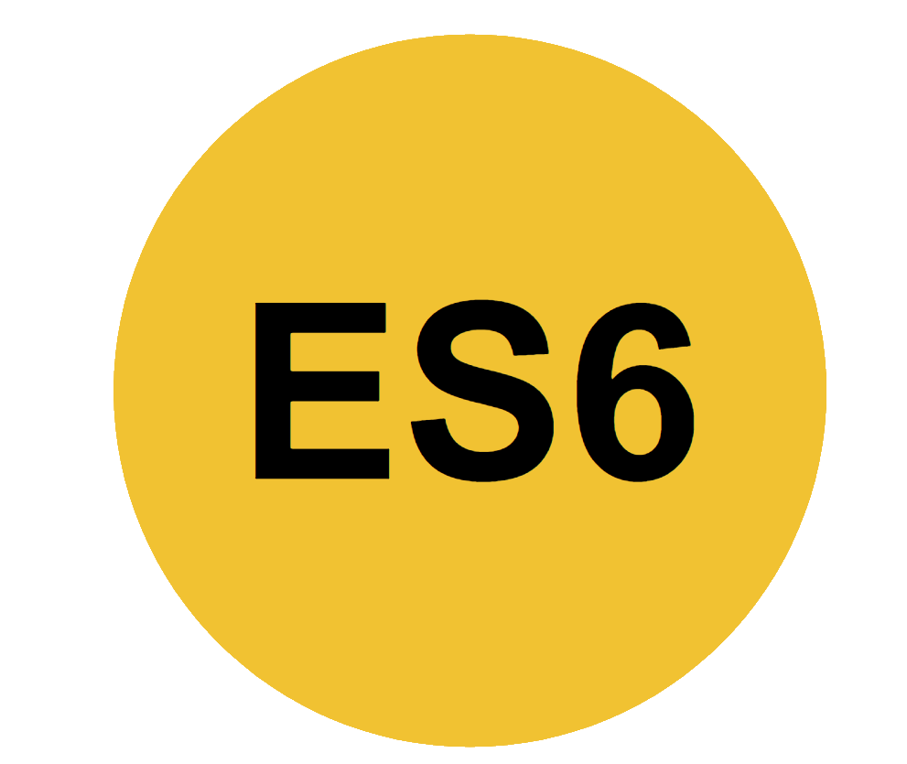
Definition Keywords
Number
1. var
Function Scoped keyword used to declare variables.
Number
2. let
Block Scoped keyword used to declare variables.
Number
3. const
Block Scoped keyword used to declare constants.

Slide 9
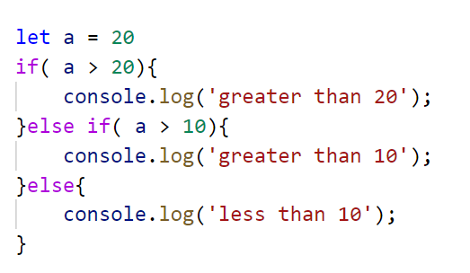
Conditions
Syntax of Conditions is same as C or Java.

Slide 10
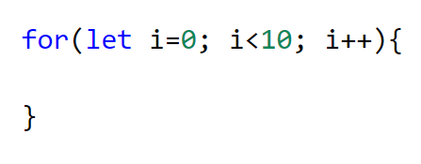
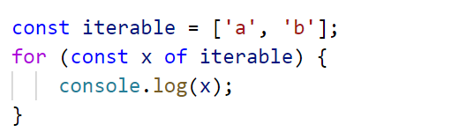
For Loop
Syntax 1
This syntax is similar to Java or C language.
Syntax 2
for-of is a new syntax in ES6 that replaces both for-in and forEach() and supports the new iteration protocol.

Slide 11
Functions
function_name = function(){ }
OR
function function_name(){ }
Method 1
This method uses function keyword to declare functions.
function_name = () => { }
Method 2
This method uses arrow operator to declare functions and the functions are called Arrow Functions..

Slide 12
Thank You

